Slide 1
CougHacks 2025
Team Image-Pass
Notes:
Remember to hit the reset button to make sure all the page elements react properly.
There are 20 different layouts that you can choose from.

Slide 2
Background
Situation
Action
As the accessibility of technology has grown, security and privacy in online spaces has become one of the most significant issues in our daily lives.
Our App allows users another form of staying secure by encoding their passwords as their favorite pictures.
Our App allows you to store your favorite pictures as your passwords.

Slide 3
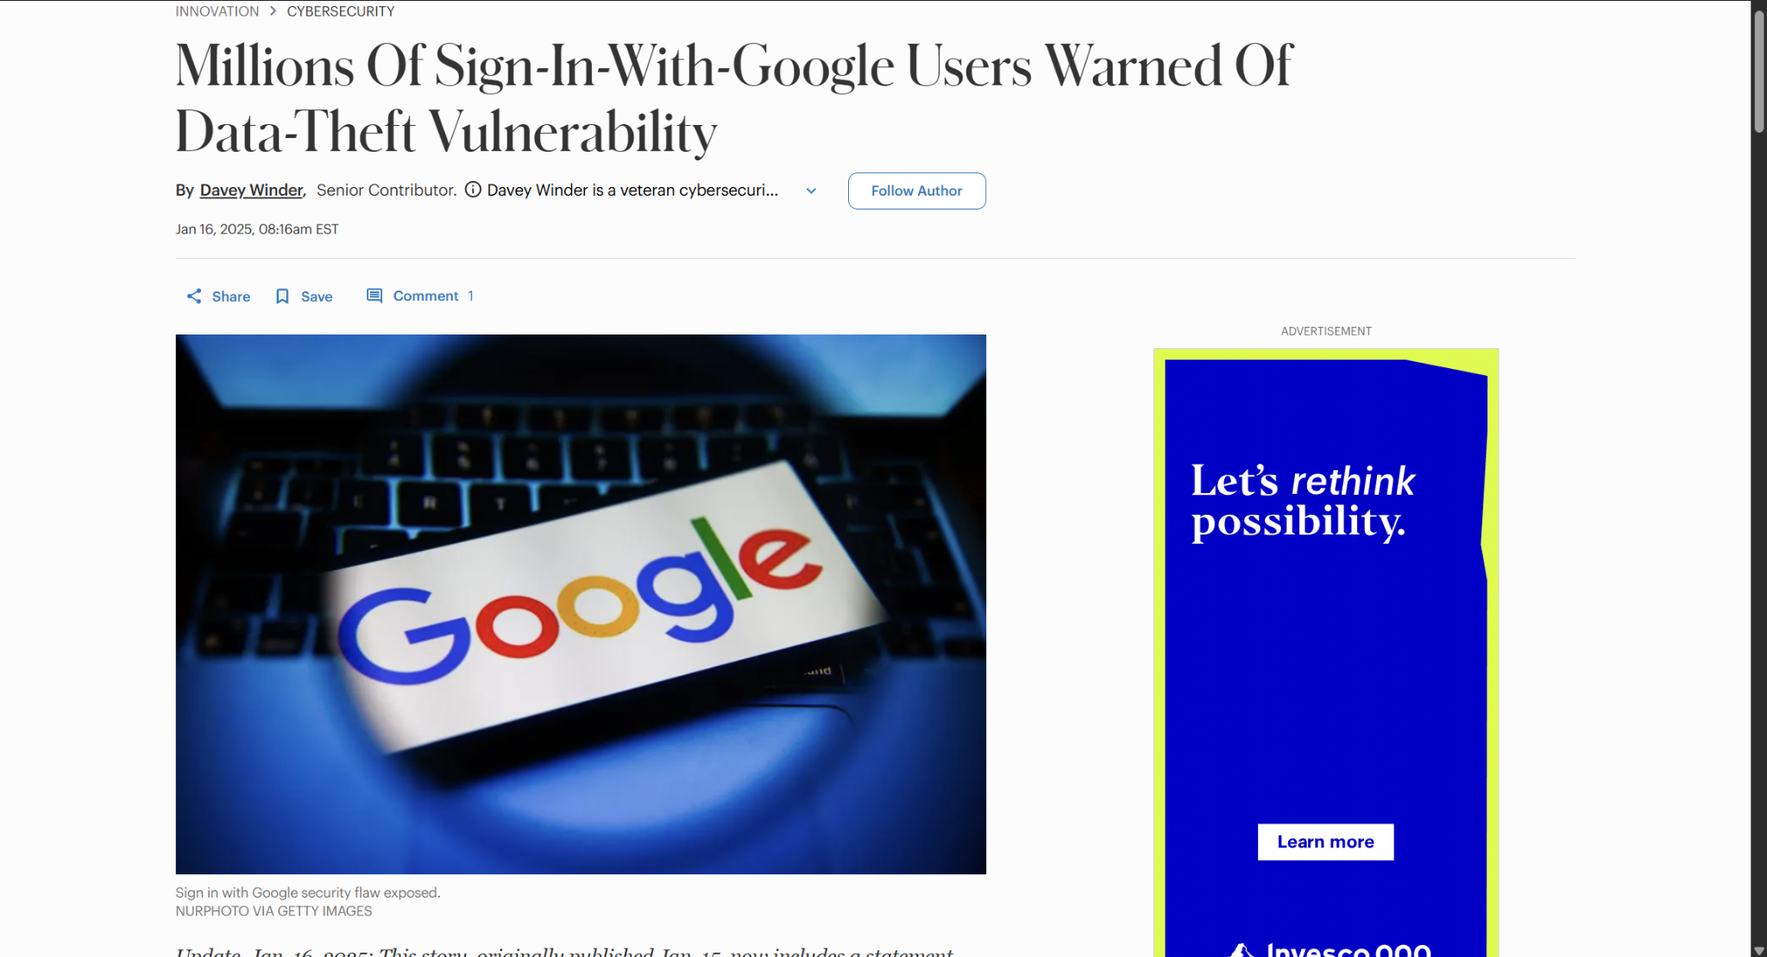
Not an “IF” but a “WHEN” Jan. 16,2025

Slide 4
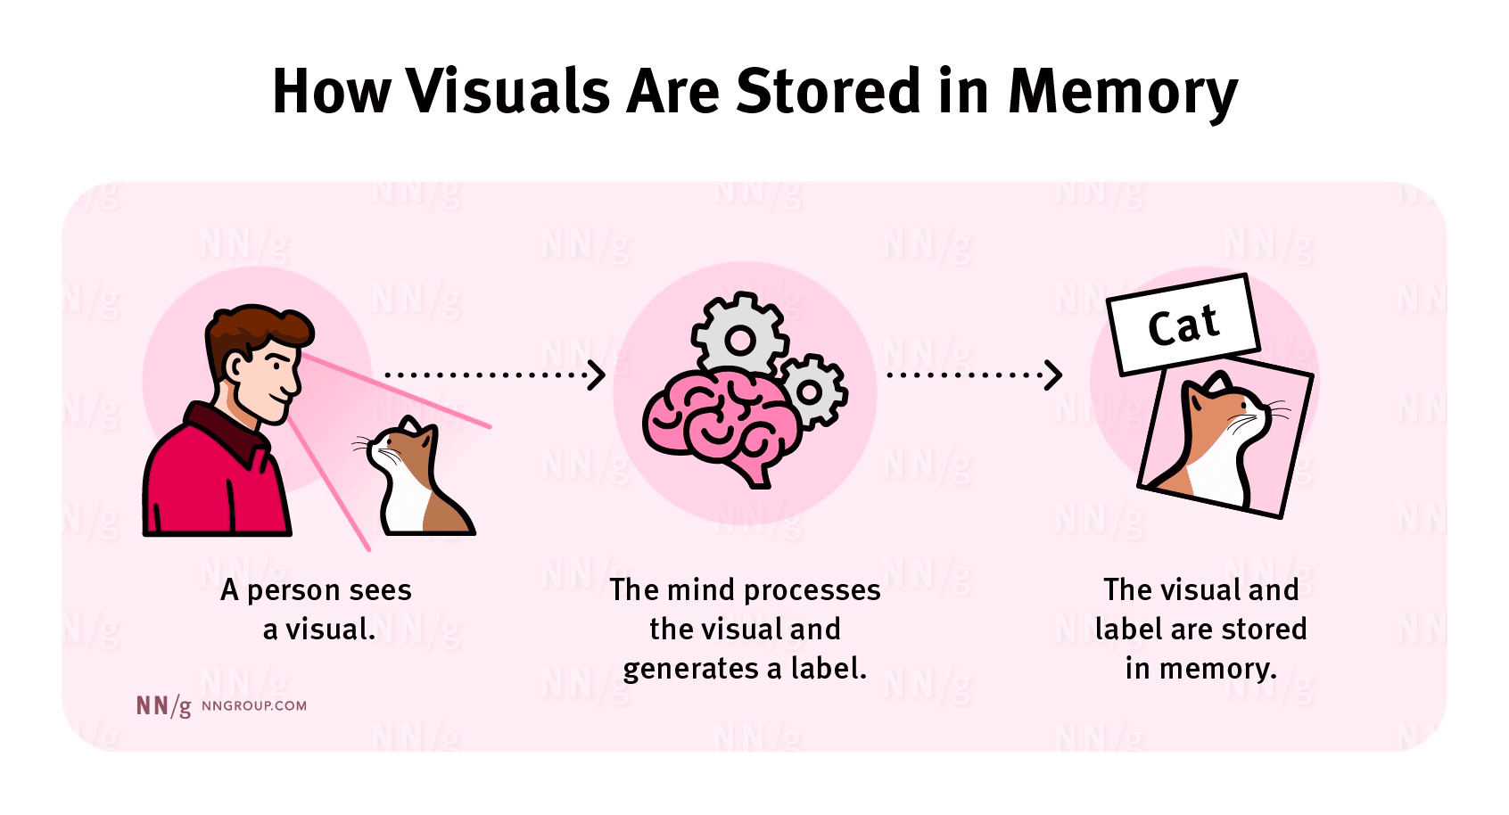
Picture Superiority Effect
The phenomenon where people remember pictures better than words, and this is often explained by the idea that our brains process and store visual information more effectively than verbal information.

Slide 5

Steganography
The art and science of concealing information by embedding a secret message within another, seemingly innocuous, message or file, aiming to hide the very existence of the hidden communication

Slide 6
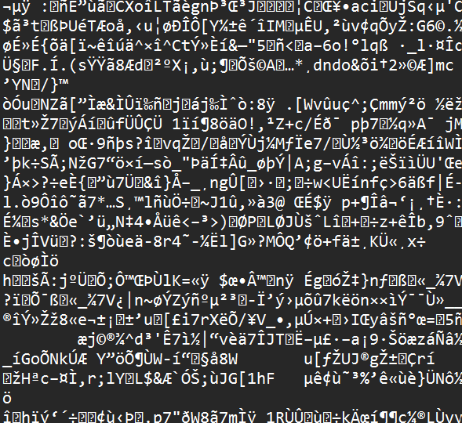
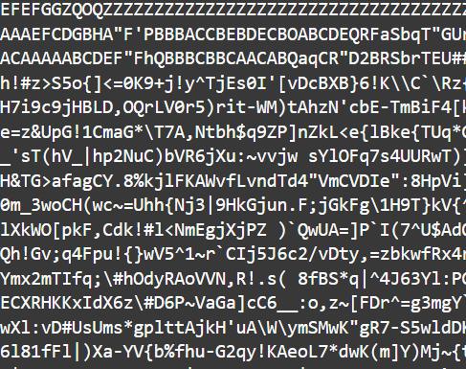
Visualization of the process

Slide 7
Visualization of the process
Valid Address Pin: 523-20
Invalid passwords without at least 1 special number and number will be handled by a corrective replacement algorithm to ensure safety
We will ensure a valid password and provide an address pin. This pin when paired with the same EXACT image it was created with can recover password consistently and securely, all while being kept offline on a local device

Slide 8
Future Work
Allow users to create their own pins
Autofilling password slots on webpages
Device specific image passcodes
Additional formats
Image strength viewer

Slide 9
Thank you for your time

